Slide 1
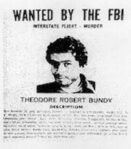
Serial Killers
Dr. Mike Aamodt
Radford University
maamodt@radford.edu
Updated 09/14/2013

Slide 2
Types of Multiple Killers
Mass Spree Serial
# of victims 4+ 2+ 2+
# of events 1 1 2+
# of locations 1 2+ 2+
Cooling-off period no no yes
Note: # of victims for serial killers was revised from 3 to 2 at the 2005 FBI-sponsored symposium on serial murder.

Slide 3
Radford/FGCU Serial Killer Database
Currently has 3,337 serial killers
  2,320 from the U.S.
  1,017 from other countries
Information on 9,289 victims (mostly U.S. and Canada)
Began with student serial killer timelines
18 years of data collection
Goals
  Accurate information for my forensic psychology class lectures
  Provide accurate information to the public
  Potentially assist law enforcement using statistical profiling models

Slide 4
Creating the Database
Compiling names of serial killers
  What is a serial killer?
    2 or more victims (this is a change in definition)
    2 separate events
    Cooling off period in between
  Determine whether person is actually a serial killer or a
    Spree killer (FBI no longer distinguishes serial and spree)
    Mass killer
    None of the above
    We eliminated 540 people found on common serial killers lists that are not actually serial killers
  Issues
    What to do with people who have killed once and clearly would have killed again had they not been caught?
    What about a person with one kill and nine attempts?
    Suspected v. confessed v. convicted
    “Organizational” serial killers

Slide 5
Organizational Killers
Serial – Individual
  Serial-Two murder
  Serial-Two events
  Serial-Three or more
Serial – Team
Serial – Organizational
  Serial-Gang
  Serial-Drug Enterprise
  Serial-Criminal Enterprise
  Serial-Cult

Slide 6
Creating the Database
Gathering Information
  Sources
    True-crime books
    Newspaper articles
    On-line prison records
    Court documents
    Ancestry.com
    Internet sites
  Issues
    Accuracy of information
    Availability of information

Slide 7
Creating the Database
Gathering Information
  Information Obtained (141 variables)
    Demographics (age, sex, race, country, state, city)
    Childhood info
      Birth order, raised by, teased, abused
    Education and IQ
    Vocational and military history
    Criminal and forensic record
    Information about the crime
      Method, victim, location, partner
    Information about the trial
      NRGI, sentence, confession,
  New Section on Victims
    Names & dates
    Excellent check for data accuracy and will be useful in studying victims rather than killers
    Information on 9,289 U.S. and Canadian victims to date

Slide 8
Classifying the Killers
Motive
  Financial, thrill, power, revenge, anger, convenience
Victim
  Age, sex, race
  High risk vs. low risk
  Acquaintance vs. stranger
Location (e.g., home invasion, street, hospital)
Method
  Strangle, bludgeon, shoot, stab, suffocate, poison

Slide 9
Classifying the Killers
Kills family
  Black widow (financial gain)
  Bluebeard (power)
  Attention (Munchhausen by proxy)
Kills patients or other dependents
  Angel of death (power)
  Lethal caretakers (financial gain)
  Baby farmers (financial gain)

Slide 10
Classifying the Killers
Home invasion
  Rape or no sex
  Robbery or just killing
  Age of victim (elderly, family, adult female)
  Type of weapon used
  Torture?
  Overkill or mutilation?
  Staging, posing, totems?

Slide 11
Problems with Dates
Date of Victim Death
Date victim actually died
Date of attempted kill (might be different if the person was in the hospital for several days before death)
Date last seen
Date reported missing
Date body was found
Date reported by killer
Source differences
  State death index
  Social security index
  Prison Inmate Locator information
  Court transcripts
  Media reports

Slide 12
Problems with Locations
City, County, State
Location of abduction
Location of killing
Location where body was dumped
Location where body was found
Burial location
Obituary location

Slide 13
Serial Killer Frequency
Hickey (2010)
  352 males and 64 females in U.S. from 1826-2004
  158 males and 30 females in U.S. from 1970-2004
Gorby (2000)
  300 international serial killers from 1800-1995
Radford University Data Base (9/14/2013)
  3,337 serial killers
    US: 2,320
    International: 1,017
  Number of serial killers varies with each update because many names listed as serial killers are not actually serial killers and new serial killers are added
Updated 09/14/2013

Slide 14
Serial Killers by Country
2,320 United States
115 England
97 Italy
95 South Africa
79 Japan
71 Germany
61 Canada
55 Australia
47 France
44 India
39 Russia
30 China
22 Mexico
14 Brazil
12 Scotland
10 Poland

Slide 15
Country | Percentage of World Population | Percentage of Serial Killers | Ratio
United States | 4.47 | 69.5 | 15.55
Australia | 0.33 | 1.6 | 4.85
Italy | 0.87 | 2.9 | 4.25
Canada | 0.50 | 1.8 | 4.20
United Kingdom | 0.94 | 3.9 | 4.15
South Africa | 0.72 | 2.8 | 3.89
Germany | 1.17 | 2.2 | 2.22
France | 0.94 | 1.4 | 1.49
Japan | 1.82 | 2.4 | 1.32
Poland | 0.55 | 0.3 | 0.75
Russia | 2.04 | 1.2 | 0.59
Mexico | 1.60 | 0.7 | 0.44
Brazil | 2.75 | 0.4 | 0.15
India | 17.28 | 1.3 | 0.08
China | 19.24 | 0.9 | 0.05

Slide 16
Problems with International Comparisons
Language issues in finding serial killers in other countries
Easier to find the “two kill” people in the U.S. than in other countries
Centralization of records
Media policy about publicizing murders

Slide 17
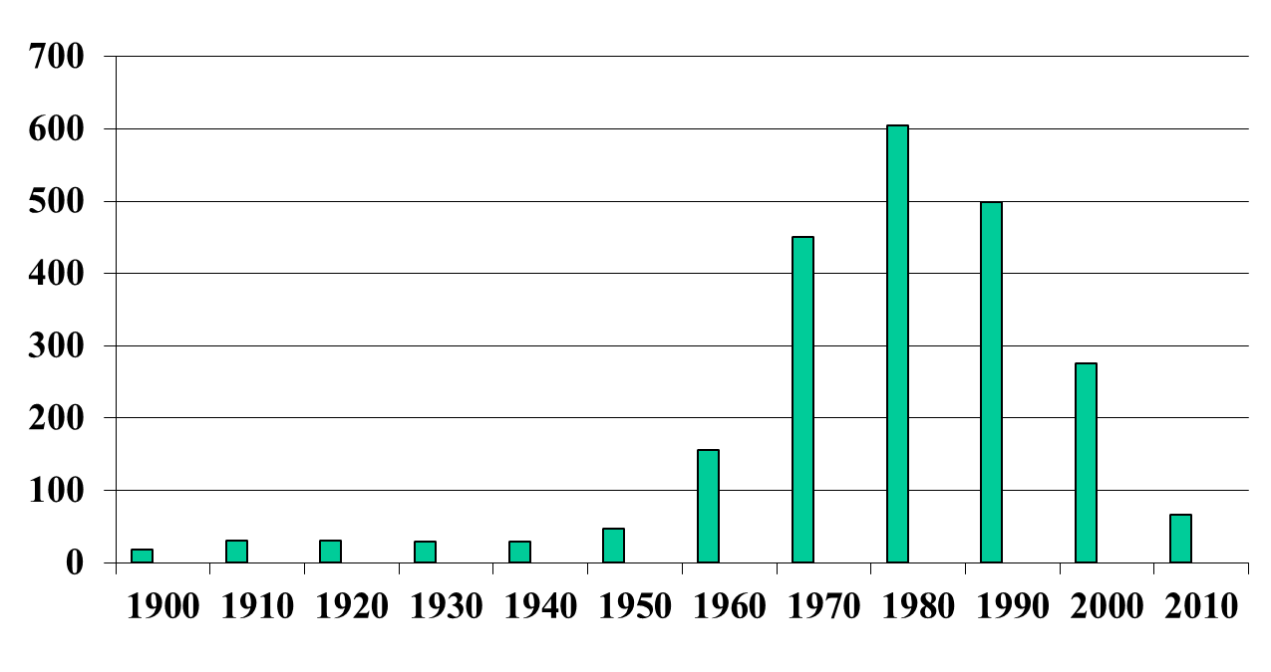
U.S. Serial Killers by Decade
(Decade of First Kill)
18
30
30
29
29
47
156
450
604
498
275
66
Updated 9/08/2013

Slide 18
Serial killing has declined in the U.S. since the 1980s
Decade | U.S. | Canada | Other Countries | Total
1900 | 18 | 0 | 11 | 29
1910 | 30 | 0 | 13 | 43
1920 | 30 | 2 | 23 | 55
1930 | 29 | 0 | 22 | 51
1940 | 29 | 3 | 29 | 61
1950 | 47 | 1 | 30 | 78
1960 | 156 | 5 | 56 | 217
1970 | 450 | 13 | 107 | 567
1980 | 604 | 12 | 150 | 759
1990 | 498 | 12 | 215 | 725
2000 | 275 | 9 | 155 | 439
2010 | 66 | 3 | 26 | 95

Slide 19
Trends in Murder Rates: United States
Year | Murder Rate (per 100,000)
1960 | 5.1
1970 | 7.9
1980 | 10.2
1990 | 9.4
2000 | 5.5
2010 | 4.8
2011 | 4.7

Slide 20
International trend is more complex
Decade | U.S. | Canada | S. Africa | U.K. | Japan | Australia | Russia | Italy
1900 | 18 | 0 | 1 | 3 | 2 | 2 | 0 | 0
1910 | 30 | 0 | 0 | 2 | 1 | 0 | 0 | 0
1920 | 30 | 2 | 3 | 6 | 2 | 2 | 2 | 2
1930 | 29 | 0 | 1 | 5 | 3 | 3 | 0 | 2
1940 | 29 | 3 | 1 | 6 | 5 | 3 | 0 | 1
1950 | 47 | 1 | 1 | 6 | 4 | 1 | 0 | 2
1960 | 156 | 5 | 1 | 9 | 11 | 3 | 2 | 5
1970 | 450 | 13 | 2 | 19 | 17 | 10 | 2 | 16
1980 | 604 | 12 | 12 | 21 | 12 | 10 | 5 | 20
1990 | 498 | 12 | 31 | 20 | 16 | 9 | 15 | 33
2000 | 275 | 9 | 34 | 14 | 4 | 2 | 6 | 7
2010 | 66 | 3 | 4 | 3 | 0 | 0 | 2 | 0
Totals do not include serial killers operating in multiple countries

Slide 21
Why the decrease in the U.S.?
Technology
  Insurance fraud is more difficult
  Killing multiple patients is not likely to go unnoticed
Longer prison sentences keep potential serial killers in prison
Law enforcement efforts
  Catch single murder more quickly (e.g., DNA)
  Efforts on terrorism reduce the FBI’s ability to link serial murders
Fewer available victims (Aamodt & Surrette, 2013)

Slide 22
Fewer Targets: We Have Changed our Behavior
Hitchhiking Related
  Hitchhiking
  Offering rides
  Accepting an offer to “get in”
Disabled Motorists
  Offering assistance
  Accepting assistance
Free-Range Kid Behavior
  Walking to and from school or the store
  Riding bicycles
  Playing in the park
  Fishing and hiking alone

Slide 23
Serial Killer Victims in the U.S. & Canada
Decade | # Victims | % ages 6-17
1900 | 113 | 8.9
1910 | 167 | 6.6
1920 | 139 | 11.5
1930 | 84 | 14.3
1940 | 84 | 13.1
1950 | 153 | 15.7
1960 | 347 | 21.6
1970 | 1,342 | 22.5
1980 | 2,181 | 14.1
1990 | 1,847 | 9.2
2000 | 1,114 | 8.0
2010 | 272 | 4.0
Note: Victims represent those from serial killers who were caught and for whom we know the circumstances of their abduction or death

Slide 24
Serial Killer Victims (age 6-17) by selected category
Victim Category | 1950 | 1960 | 1970 | 1980 | 1990 | 2000 | 2010 | TOTAL | % Change 1980-2000
Park | 0 | 10 | 9 | 8 | 2 | 0 | 1 | 30 | 0.0%
Shopping center/Parking lot/School | 0 | 1 | 19 | 16 | 6 | 0 | 0 | 42 | 0.0%
Prostitute | 0 | 0 | 8 | 37 | 6 | 2 | 0 | 53 | 5.4%
Hitchhiking related | 4 | 4 | 57 | 30 | 5 | 2 | 0 | 102 | 6.7%
Street - Walking/Riding a bicycle | 7 | 18 | 65 | 73 | 37 | 8 | 1 | 209 | 11.0%
Employee or customer | 0 | 2 | 15 | 7 | 15 | 1 | 1 | 41 | 14.3%
Rural (e.g., fishing, hiking) | 2 | 9 | 13 | 6 | 5 | 1 | 0 | 36 | 16.7%
Street - Public Transportation | 1 | 0 | 6 | 5 | 1 | 1 | 0 | 14 | 20.0%
Street | 0 | 2 | 16 | 24 | 7 | 6 | 1 | 56 | 25.0%
Home or home invasion | 3 | 7 | 34 | 38 | 30 | 10 | 1 | 123 | 26.3%
Met at a bar, skating rink, etc. | 0 | 0 | 4 | 4 | 3 | 2 | 0 | 13 | 50.0%
Friend or acquaintance | 0 | 7 | 29 | 31 | 12 | 16 | 0 | 95 | 51.6%
Girlfriend/Boyfriend Related | 0 | 4 | 1 | 7 | 9 | 4 | 1 | 26 | 57.1%
Street - Runaway | 0 | 0 | 0 | 2 | 6 | 2 | 1 | 11 | 100.0%
Family | 7 | 10 | 9 | 13 | 9 | 14 | 2 | 64 | 107.7%
Drug or gang related | 0 | 0 | 0 | 5 | 12 | 21 | 0 | 38 | 420.0%
TOTAL | 24 | 75 | 302 | 311 | 170 | 89 | 11 | 982 | 29.4%

Slide 25
Serial Killer Victims (all ages) by selected category
Victim Category | 1950 | 1960 | 1970 | 1980 | 1990 | 2000 | 2010 | TOTAL | % Change 1980-2000
Shopping Center/School | 0 | 1 | 21 | 33 | 17 | 2 | 0 | 74 | 6.1%
Disabled motorist or good Samaritan | 0 | 1 | 19 | 16 | 2 | 1 | 1 | 40 | 6.3%
Hitchhiking related | 11 | 14 | 138 | 87 | 24 | 9 | 0 | 283 | 10.3%
Law enforcement | 2 | 2 | 17 | 18 | 13 | 2 | 11 | 65 | 11.1%
Street - Walking/Riding a bicycle | 8 | 25 | 97 | 119 | 81 | 20 | 12 | 362 | 16.8%
Park | 0 | 12 | 19 | 13 | 7 | 3 | 2 | 56 | 23.1%
Employee or customer | 21 | 54 | 135 | 173 | 166 | 47 | 11 | 607 | 27.2%
Family | 34 | 58 | 93 | 127 | 101 | 64 | 17 | 494 | 50.4%
Friend or acquaintance | 8 | 31 | 96 | 199 | 120 | 118 | 32 | 604 | 59.3%
Prostitute/John | 0 | 4 | 36 | 273 | 339 | 166 | 28 | 846 | 60.8%
Prison guard/inmate | 6 | 6 | 8 | 21 | 22 | 15 | 5 | 83 | 71.4%
Girlfriend/Boyfriend Related | 2 | 14 | 21 | 73 | 81 | 55 | 22 | 268 | 75.3%
Street – Parking lot | 0 | 3 | 17 | 14 | 20 | 16 | 2 | 72 | 114.3%
Drug or gang related | 0 | 2 | 26 | 89 | 173 | 190 | 33 | 513 | 213.5%
Street – Drug addict | 0 | 0 | 0 | 9 | 32 | 31 | 0 | 72 | 344.4%
TOTAL | 153 | 347 | 1342 | 2181 | 1847 | 1114 | 272 | 7843 | 51.1%

Slide 26
Serial Killer Victims (all ages) Most Frequent 1950-2010
Victim Category | 1950 | 1960 | 1970 | 1980 | 1990 | 2000 | 2010 | TOTAL
Home or home invasion | 22 | 58 | 283 | 399 | 296 | 168 | 38 | 1,264
Prostitute or john | 0 | 4 | 36 | 273 | 339 | 166 | 28 | 846
Employee or customer | 21 | 54 | 135 | 173 | 166 | 47 | 11 | 607
Friend or acquaintance | 8 | 31 | 96 | 199 | 120 | 118 | 32 | 604
Drug or gang related | 0 | 2 | 26 | 89 | 173 | 190 | 33 | 513
Family | 34 | 58 | 93 | 127 | 101 | 64 | 17 | 494
Street – Walking/Riding Bicycle | 8 | 25 | 97 | 119 | 81 | 20 | 12 | 362
Hitchhiking related | 11 | 14 | 138 | 87 | 24 | 9 | 0 | 283
Girlfriend/Boyfriend Related | 2 | 14 | 21 | 73 | 81 | 55 | 22 | 268
Met at a bar or similar | 2 | 8 | 57 | 75 | 88 | 31 | 3 | 264
Patient | 0 | 9 | 39 | 96 | 61 | 43 | 0 | 248
Rural (e.g., fishing, hiking) | 2 | 113 | 40 | 36 | 25 | 11 | 1 | 128
Street – Homeless | 12 | 3 | 7 | 39 | 29 | 14 | 9 | 113
Prison guard or inmate | 6 | 6 | 8 | 21 | 22 | 15 | 5 | 83
Street – Drug addict | 0 | 0 | 0 | 9 | 32 | 31 | 0 | 72
Note: List does not include over a thousand killed on the street in general
Victims are U.S. and Canada only

Slide 27
Serial Killer Age
Age at the start of the series
Potential problems
  Should we use age at first kill rather than first kill in series?
    2% killed prior to the start of the series
  Should we use age at first attempted murder?
  Many of the older serial killers spent time in prison prior to their series
Simple descriptive statistics
  Mean = 27.9 (SD = 9.3)
  Median = 26
  Youngest = 9 (Robert Dale Segee, final kill was at age 21)
  Oldest = 72 (Ray Copeland)
Only 26.9% actually fall into their mid-to-late 20’s (24 – 29)
Updated 09/14/2013

Slide 28
General Serial Killer Profile
Age at First Kill
Source | N | Mean
Our data (2013) | 2,973 | 27.9
Kraemer et al. (2004) | 157 | 31
Hickey (2013) |  | 28.0
Updated 09/14/2013

Slide 29
General Serial Killer Profile
Demographics – Average age is 27.9
Males
  27.7 is average age at first kill
    9 is the youngest (Robert Dale Segee)
    72 is the oldest (Ray Copeland)
  Jesse Pomeroy (Boston in the 1870s)
    Killed 2 people and tortured 8 by the age of 14
    Spent 58 years in solitary confinement until he died
Females
  30.6 is average age at first kill
    11 is youngest (Mary Flora Bell)
    66 is oldest (Faye Copeland)
Updated 09/14/2013

Slide 30
A Problem with Profiling
Typical Serial Killer Profile in the Media
  A white, male, in his mid to late twenties
Statistics (U.S. Serial Killers)
  Male (92.1%)
  White (52.7%)
  Mid to late twenties (26.9%)
  White, male (46.1%)
  White male in his mid to late twenties (12.7%)
Updated 09/14/2013

Slide 31
Gender Changes Across Time
U.S. & International Serial Killers
Decade | Men | Women
2010 | 94.7% | 5.3%
2000 | 93.4% | 6.6%
1990 | 92.7% | 7.3%
1980 | 92.2% | 7.8%
1970 | 94.2% | 5.8%
1960 | 91.7% | 8.3%
1950 | 84.6% | 15.4%
1940 | 86.9% | 13.1%
1930 | 84.3% | 15.7%
1920 | 78.2% | 21.8%
1910 | 69.8% | 30.2%
1900 | 62.1% | 37.9%
TOTAL | 90.6% | 9.4%
Updated 09/14/2013

Slide 32
Race
Most media sources suggest that non-White serial killers are rare
Justin Cottrell (2012)
  Rise of the Black Serial Killer
  Found hundreds of Black serial killers that were not on other lists
  Extensive search was useful but might now overestimate the percentage of Black serial killers because a similar extensive search was not used for other races (including Whites)

Slide 33
General Serial Killer Profile
Race
Race | U.S. N=2,221 | U.S. & International N=3,297
White | 52.5% | 55.9%
Black | 40.7% | 31.2%
Hispanic | 5.3% | 5.6%
Asian | 0.7% | 6.6%
Native American | 0.9% | 0.6%
Updated 09/14/2013

Slide 34
Racial Changes Across Time
U.S. Serial Killers
Decade | White | Black | Hisp | Asian | N
2010 | 33.3% | 59.1% | 7.6% | 0.0% | 66
2000 | 32.4% | 59.6% | 6.9% | 0.7% | 275
1990 | 43.1% | 48.0% | 7.1% | 1.8% | 494
1980 | 55.6% | 35.4% | 6.8% | 0.5% | 601
1970 | 62.4% | 32.9% | 3.4% | 0.4% | 447
1960 | 70.3% | 27.1% | 0.6% | 0.0% | 155
1950 | 78.7% | 21.3% | 0.0% | 0.0% | 47
1940 | 65.5% | 27.6% | 3.4% | 0.0% | 29
1930 | 58.6% | 41.4% | 0.0% | 0.0% | 29
Updated 09/14/2013

Slide 35
Serial Killing is a White Thing
1980-2009
 | Serial Killers | 1980, 1990, 2000 Census
White | 46.4% | 74.40%
Black | 44.8% | 11.95%
Hispanic | 6.9% | 9.55%
Asian | 1.0% | 2.81%
Native Am. | 0.8% | 2.81%
Updated 09/14/2013

Slide 36
Race
Prolific African American Serial Killers
44 Jake Bird
27 Coral Eugene Watts
23 Wayne Williams
19 Edward Suratt
17 Clementine Barnabet
Milton Johnson
16 John Muhammad/Lee Boyd Malvo
Vincent Darrell Groves
15 Richard Jameswhite
Fred Glover
O’Delle, Pearl, & Peyton Jackson
John Reed
14 Jesse Lee Cooks
Larry Green
Vincent Groves
Hulon Mitchell
Manuel Moore
J.C.X. Simon
Chester Dwayne Turner
Clarence Walker

Slide 37
Race
Prolific Hispanic Serial Killers
27 Angel Colon Maldonado
25 Juan Corona
23 Adolfo Constanzo
16 Richard Ramirez
Angel Maturino Resendiz
12 Robert Rubane Diaz
Timothy Joseph McGhee
11 Juan Chavez
10 Eddie Seda
9 Jorge Beniquez
9 Rolando Garcia
9 Alfredo R. Prieto
9 Dorothea Puente
7 Fernando Cota
7 Tondy Herrera
7 Diana Lumbrera
7 David Villarreal
6 Juan Cordoba
6 Timothy Joseph McGhee
6 Paul Ruiz
6 Efren Saldivar
5 Ricardo Caputo
5 Ramon T. Hernandez
5 Leslie Torres

Slide 38
Race
Prolific U.S. White Serial Killers
49 Gary Ridgeway
48 Amy Archer-Gilligan
41 Billy Gohl
Belle Gunness
40 Charles Cullen
37 Donald Harvey
36 Ted Bundy
35 Dr. Michael Swango
34 Gerard Schaefer
33 John Wayne Gacy
Bruce Alan Davis
32 Patrick Kearney
31 Jane Toppan
30 Stanley Bernson
Morris Bolber
29 Charles Cullen
28 David Douglas Hill
27 Dean Corrl, David Brooks
Elmer Henley
Herman Mudgett

Slide 39
Serial Killer IQ
Media/Internet
  High IQ
Our Database (N = 217)
  Mean = 94.1
  Median = 87.0
  Range (54 – 165)
Number of Kills
  Two (90.2)
  Three (88.7)
  Four (95.1)
  Five (95.9)
  More than five (98.7)
Rape
  Yes (94.0)
  No (94.5)
Type
  Organized (98.5)
  Disorganized (92.7)
Method of Killing
  Bomb (140.3)
  Strangle (98.1)
  Stab (94.0)
  Gun (92.4)
  Bludgeon (84.5)
Updated 09/08/2013

Slide 40
Are IQ Scores Reliable?
You can fake dumb, but you can’t fake smart
People scoring lower than 70 cannot be executed (Atkins v. Virginia, 2002)
David Leonard Wood
  1977 – Age 19 – 111
  1980 – Age 23 – 64
  1980 – Age 23 – 101
  2011 – Age 54 – 75 (death sentence appeal)
    Psychologist thought Wood was faking low
    Wood correctly used “big words” in his letters

Slide 41
Intelligence
The Smart
165 Ted Kaczynski (155)
160 Charlene Gallego
152 Carroll Cole
145 Rudy Bladel
Ed Kemper (136)
Ronald Williams
Herbert Coddington (142)
140 Charles Albright
Robert Browne
Harvey Glatman (130)
138 James Clifford Carson
136 Ted Bundy (125)
134 Thomas Dillon
William Christenson
130
  Lawrence Bittaker
  Juan Corona
  Gary Heidnik (148)
  Walter Leroy Moody (125)
  Marcel Petiot (135)
  Angel Resendez
  Gerard Schaefer
129 Bill Heirens
Paul Knowles
Randy Kraft
128 Joel Rifkin

Slide 42
Intelligence
The Not So Smart
54 Donnie Gene Craig
57 Simon Pirela
58 John Staffen
60 Eugene Britt
62 Willie James Hodges (66)
63 Arthur Goode
64 John Thomas Straffen (58)
Arthur Culombe
65 Albert Dyer
Derrick Todd Lee (91)
Sean Paul Hanify
Karl Lee Myers (75)
Charles Ng
66 Elroy Chester (69)
Charles Troy Coleman
67 Sean Paul Hanify
Donald William Dufour (62)

Slide 43
Family Comparison
 | Serial Killers | U.S. Population*
Birth parent/s | 85.03% | 87.4%
Adopted | 5.39% | 2.2%
Relative | 5.24% | 8.3%
Foster home | 2.54% | 0.4%
Orphanage | 1.35% | ?
Abandoned | 0.45% | ?
Other |  | 1.7%
 | N =668 | 2000 Census
*O’Hare (2008; Table 2)
Updated 09/14/2013

Slide 44
Birth Order Comparison
 | U.S. Serial Killers | U.S. Presidents | U.S. Population
First Born | 30.7% | 33.3% | 28.36
Middle Born | 32.5% | 50.0% | 15.90
Youngest | 26.2% | 14.3% | 28.36
Only Child | 10.6% | 2.4% | 27.39
 | N = 501 |  | 2000 Census
Updated 09/14/2013

Slide 45
General Serial Killer Profile
Childhood
Unstable home
Absence of loving and nurturing relationship
Physical ailments and disabilities
Head injuries
Triad
  bed wetting
  fire starting
  animal torture

Slide 46
Effects of the Family
Child Abuse
Comparison of Serial Killers to the General Population (Mitchell & Aamodt, 2005)
Type of Abuse | General Population | Serial Killers
Physical | 6% | 36%
Sexual | 3% | 26%
Psychological | 2% | 50%
Neglect | 18% | 18%
Other | 6% | Not applicable
No Abuse Reported | 70% | 32%

Slide 47
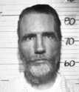
A Strange Way to Raise a Child
Gary Heidnik
3 years old
Didn’t clean room properly
Father hung him by his feet out of a 3rd story window

Slide 48
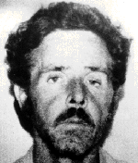
A Strange Way to Raise a Child
Henry Lee Lucas
3 years old
  Mother forced him to watch her have sex with strangers
7 years old
  Mother made him go to school dressed like a girl
  Mother beat him when his teacher gave him a pair of shoes
10 Years old
  Mother’s lover showed him how to kill animals and then have sex with them

Slide 49
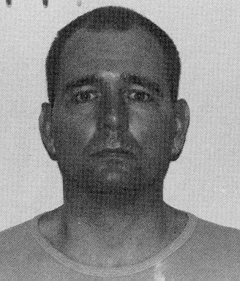
A Strange Way to Raise a Child
Danny Rolling
6 months
  Father kicked him into a wall
1 year old
  Father beat him when he crawled funny
6-8 years old
  Father beat him twice a week
13 years old
  Father handcuffs him to brother, beats them, leaves them outside

Slide 50
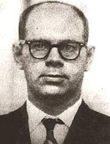
A Strange Way to Raise a Child
Robert Garrow
1 year old
  Father made him kneel for hours in the corner
2 years old
  Mother splits his head open with a crowbar during a beating
5 years old
  Knocked unconscious when mother hits him in the head with a piece of wood
6 Years old
  Beaten unconscious by his father
  Made to wear his sister’s bloomers out to play

Slide 51
General Serial Killer Profile
Forensic History
Triad
Most have a criminal history
  84.3% were previously arrested
  75.6% had spent time in jail or prison
Many received prior psychiatric treatment
11.6% spent time in a forensic unit prior to their series
2.0% killed prior to their serial killing
  This is a difficult statistic to accurately compute
Updated 09/08/2012

Slide 52
Categorizing the Serial Killer
Killer
  sex, race, age
  IQ
  psychopathology
Crime Scene
  type of weapon
  use of torture
  attempt to hide body
  location
Motive
  sex
  power
  financial gain
Victim
  sex, race, age
  occupation
  personality

Slide 53
Type of Victim
____________________________________________________
Spouse, Random Specific Specific
Motive Family Strangers Type Strangers Employees Patients
________ ______ ________ _______ ________ _________ _______
Money Black Contract Cost Lethal
Widow Killer Cutter Caretaker
Sex Disorganized Organized
Lust Lust
Thrill Disorganized Organized
Thrill Thrill
Power Bluebeard Angels of
Death
Revenge Revenge
Psychosis Visionary
Hate Missionary
Attention Munchausen Munchausen
No motive Anti-social

Slide 54
Broad Motive
Broad Motive (2,507 killers) | %
Enjoyment (thrill, lust, power) | 48.6
Financial gain | 30.5
Anger | 8.4
Multiple Motives | 6.9
Gang Activity | 2.9
Avoid arrest | 1.1
Attention | 0.6
Convenience | 0.5
Hallucinations | 0.4
Cult | 0.2

Slide 55
Types of Serial Killers
Visionaries
Psychotic - told to kill
  paranoia, schizophrenia
  1% of killers are psychotic (Henn et al., 1976)
Examples
  Herbert Mullin
  Miguel Rivera
  Joseph Kallinger

Slide 56
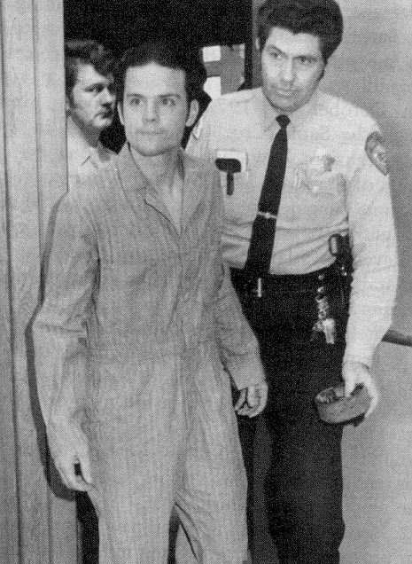
Herbert Mullin
Crimes
  Operated during 1972-1973
  Killed 13 in Santa Cruz, CA
  Shot most of his victims
Vision
  Voices told him to shave his head and burn his penis with a cigarette (he obeyed)
  Voices told him to kill in order to prevent a catastrophic earthquake

Slide 57
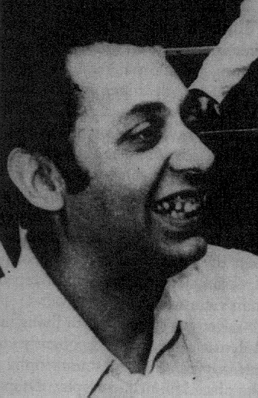
Joseph Kallinger
Crimes
  Operated during 1974-1975
  Murdered 3 in NJ and PA (including one of his sons)
  Robbed and assaulted many others
  His 13 year old son was his accomplice
Vision
  Told by God (through a large floating head with tentacles) to murder young boys and sever their genitals

Slide 58
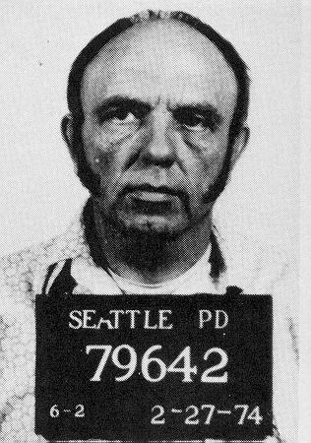
Harvey Carignan
Crimes
  Known as the “Want-ad Killer”
  Operated in Seattle 1973-1974
  Killed 3 (probably many more) by smashing their skull with a hammer
Vision
  Told by God to kill women
  God didn’t tell him why

Slide 59
Types of Serial Killers
Missionaries
Kill to “Clean-up” world
Examples
  Joseph Franklin
    Killed interracial couples and African Americans
    Wounded Vernon Jordan and Larry Flynt (Hustler Magazine)
  Wolfgang Abel
    Killed drug addicts
  Axe Man of New Orleans
    Killed 11 (most were Italian grocers)
  Carroll Cole

Slide 60
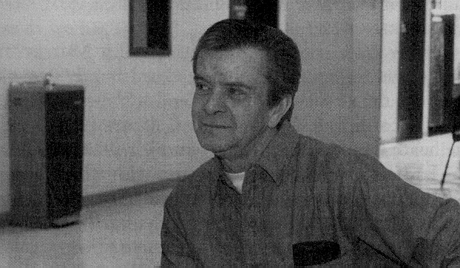
Carroll Edward Cole
Crimes
  Operated during 1975-1980
  Killed at least 13 women in several western states
Mission
  Rid the world of loose women
  All his victims cheated on their significant-other with Cole

Slide 61
Types of Serial Killers
Hedonists
Kill for fun or profit
Subtypes
  Lust Killers (kill for sexual gratification)
    Organized
    Disorganized
    Mixed
  Thrill Killers (kill for the thrill of killing)
  Gain Killers
    Contract Killers
    Black Widows
    Lethal Caretakers
    Cost Cutters

Slide 62
Examples of Lust Killers
Organized Killers
  Ted Bundy
  John Gacy
  Chris Wilder
  Kenneth Bianchi
  Ed Kemper
Disorganized Killers
  Arthur Shawcross
  Richard Chase
  Jeffrey Dahmer
  Danny Rolling

Slide 63
Hedonists-Gain Killers
Black Widows
The Crime
  Kill husbands, lovers, or relatives for financial gain
  Almost always women
  Almost 90% use poison to kill their victims
Examples
  Diana Lumbrera (killed her 6 children for insurance)
  Nanny Hazel Doss (killed 4 husbands, 2 sisters, 1 mother)
  Lydia Trueblood (killed 4 husbands, 1 child, brother in-law)
  Amy Gilligan (killed 5 husbands, several patients)

Slide 64
Hedonists - Gain Killers
Cost Cutters
Crime
  Kill to save money
Examples
  Joseph Briggen
    Killed 12 ranch hands when their pay was due
    Fed the people to his prize-wining pigs
  Georg Grossman
    Killed over 50 people, put the meat into his hotdogs
  Joe Ball

Slide 65
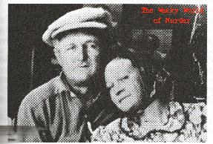
Joe Ball
Operated during the late 1930s
Killed at least 5, probably 14, waitresses at his tavern (The Sociable Inn) in Texas
Threw them into a pit with 5 alligators in the back of the tavern

Slide 66
Hedonists-Gain Killers
Lethal Caretakers - Profit
The Crime
  Kill patients for profit
  Usually women
Examples
  Dorthea Puente killed 7 elderly to cash social security checks
  Antoinette Scieri killed 12 elderly patients so that she could take their assets
  Anna Hahn poisoned 5 elderly men she cared for to get their insurance

Slide 67
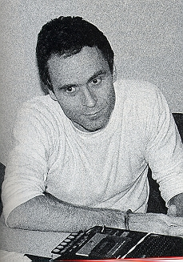
Types of Serial Killers
Power Seekers
Kill to exert power over strangers
Examples
  Ted Bundy
  David Berkowitz
  Angelo Buono
  Edward Kemper

Slide 68
Power Seekers
Angels of Death
The Crime
  Usually women
  Kill patients for feelings of power and control
Examples
  Genene Jones - As a nurse, she killed between 11and 46 babies by injecting them with a muscle relaxant
  Terri Rachals killed 9 patients through injections of potassium chloride
  David Harvey is an example of a male angel of death
  Gwendolyn Graham and Catherine Wood

Slide 69
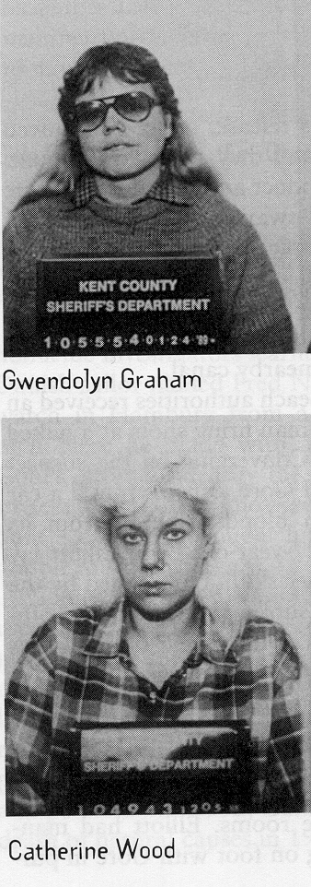
Gwendolyn Graham and Catherine Wood
Killed 5 patients in Alpine Manor (a nursing home)
Initial plan was to spell MURDER with the first letter in the last name of each victim
Graham did all the killing and Wood kept watch

Slide 70
Power Seekers
Blue Beard Killers
Males who kill their spouses
Examples
  Johann Hoch
  Henri Landru
  Harry Powers
  James Watson

Slide 71
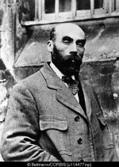
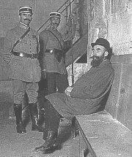
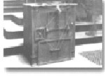
Henry Landu
Romanced more than 300 women out of their money during the early 1900s in France
Ran personal ads to meet his women
Married and killed 10 of them
Put their bodies in an oven to dispose of them

Slide 72
Lethal Caretakers
Munchausen Syndrome by Proxy
The Crime
  Kill or hurt others in order to be admired for curing them or to get sympathy for the death of a loved one
  Mostly females
Examples
  Beverly Allitt injected insulin and potassium into 26 children (4 died, 9 had irreparable brain damage) over a 58-day period
  Martha Woods - 27 respiratory attacks in 9 children resulted in 7 being killed (3 were her own children)

Slide 73
Types of Serial Killers
Revenge Killers
Kill for revenge
Examples
  Martha Wise: Killed 3 family members opposing her marriage
  Ellen Etheridge: Killed 4 of her 8 step-children because she was jealous of their relationship with her husband
  Martha Johnson
    Had 4 fights with her husband
    After each fight, suffocated a child as revenge
    Suffocated by laying on top of them (she weighed 250 pounds)

Slide 74
Types of Serial Killers
Antisocial Personalities
Definition
  Pattern of irresponsible or harmful behavior
  Lack of conscience
  Ignore social rules and laws
  Impulsive
  Fail to learn from punishment
Examples
  Gang Members
  Criminals who kill for no reason

Slide 75
The Crime Scene
Serial Killer Type .
Crime Characteristic Disorganized Organized
Body disfigured hidden
Sex after death before death
unsuccessful successful
Weapons finds at scene brings
Viciousness torture quick
Sophistication low high, learns
each time

Slide 76
The Crime Scene
Serial Killer Type .
Crime Characteristic Disorganized Organized
Totem not taken taken
Follows crime in news no yes
Victim high risk low risk
Gets to crime by walking, bus drives

Slide 77
Killer Profile
Serial Killer Type .
Characteristic Disorganized Organized
Residence close to crime further
IQ less intelligent intelligent
Employment menial or normal
unemployed
Appearance unattractive attractive
Self-image feels inferior feels superior
Social loner outgoing

Slide 78
Killer Profile
Serial Killer Type .
Characteristic Disorganized Organized
Romance lives alone affairs, short
relationships
Anger keeps inside acts out, bully,
class clown
Birth order low high
Habits nighttime daytime
Childhood discipline harsh lax or
inconsistent

Slide 79
Killer Profile
Serial Killer Type .
Characteristic Disorganized Organized
Family alcoholism,
mental illness
Father’s work unstable stable

